Slide 1
Your Child’s Baptism
2025 Edition
stmarysbattersea.org.uk

Slide 2
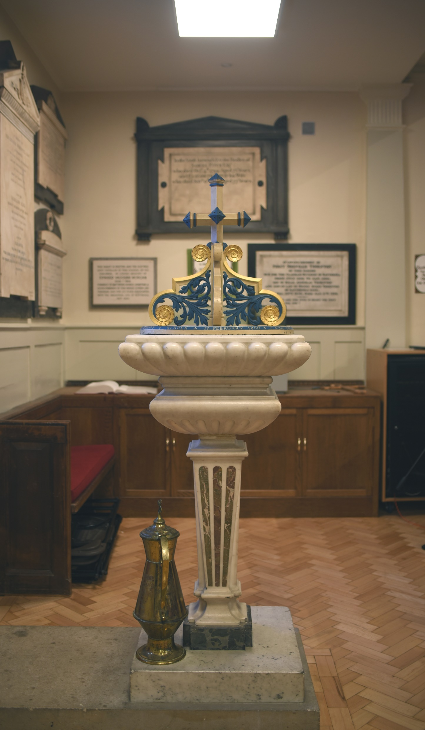
A Message from St Mary’s…
Welcome to St Mary’s and thank you for enquiring about having your child or children baptised at St Mary’s. We are thrilled that you are thinking of baptism for your child. Taking this step which marks the beginning of what we pray will
be a life-long journey of discovery of the love of God in Jesus Christ as members of God’s family.
A child’s baptism brings them into the world-wide community of Christian people known as the Church – the group of people learning what it means to respond to the invitation of Jesus to “Follow me.” At a baptism, parents and godparents make some simple but profound promises of Christian commitment on behalf of the children they bring to baptism:
I turn to Christ.
I repent of my sins.
I renounce evil.
God gives to every baptised person the gift of his love and his presence in their lives in response to these words of faith. We hope you find that love at St Mary’s and in this special moment for you and your child.

Slide 3
Baptism at St Mary’s?
We are always delighted to carry out baptisms for regular members of our congregation and for people who live within our parish boundaries. If you live outside the parish boundaries, you are welcome to join St Mary’s and, after you have settled down and started to take an active part in church life, we are happy to baptize you or your child. This will usually be around six months regular worship. Alternatively, we are happy to direct you to your local parish church where the baptism can take place.
When do Baptisms Happen?
Except in very special circumstances, baptisms happen at the main Sunday morning service at 11am. This is because we want your child to be welcomed into the church by the people of God alongside your family and friends. Being a Christian is never just a private ceremony but always involves the wider community and the new Christian family, the Church.
Because having a Baptism significantly changes the shape of the Sunday service for the whole congregation we tend to have Baptisms only once a month and we try to limit the numbers so that no more than three children are ever baptised at one service.
Baptism Dates in 2025
January 12
February 9
March 2
June 8
July 13
August 10
September 14
October 12
November 23
We tend to have baptisms in our main 11am service on a monthly basis, limiting the number of children baptised to three on each occasion. This year the dates for baptisms are planned as follows, which we hope will give you a number of options:

Slide 4
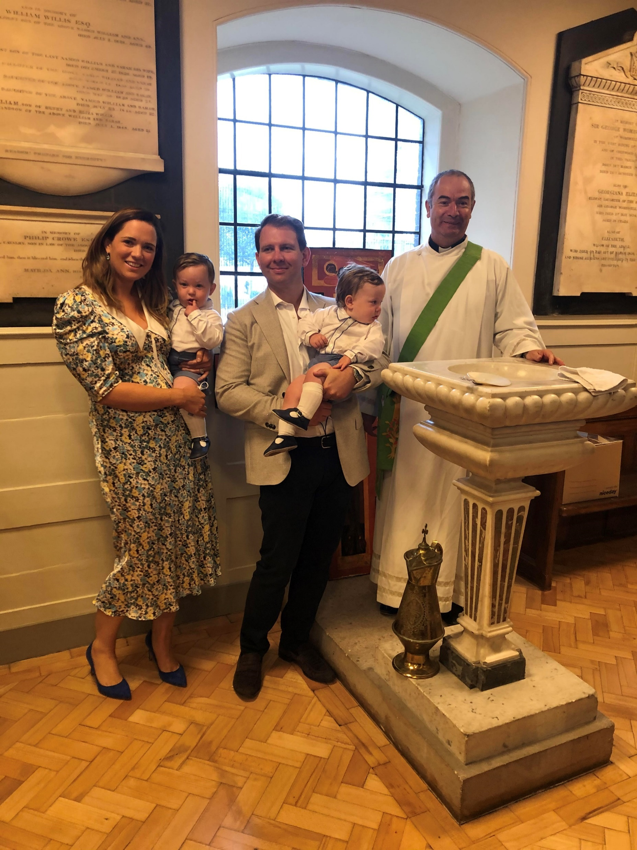
About Godparents
All children who are being baptised will need to have one godfather and one godmother. We would encourage you to have a maximum of about 4 godparents.
All godparents must themselves have been baptised and it is recommended that godparents should also be confirmed. They can belong to any mainstream Christian Church (Roman Catholic, Methodist, Baptist, Greek Orthodox etc.) but they have to be happy to support the child being brought us as a member of the Church of England. We do recognise that families often have friends of other world faiths or who do not believe, and who would not be comfortable or able to make Christian vows. While they cannot be godparents, we can provide some special words for these important people to say that avoid compromise or confusion. Please speak to the clergy about this.
To find out more:
churchofenglandchristenings.org/godparents
Words for an unbaptised supporter to say:
I pledge my love, care and support for N this day. I welcome his/her baptism into the Christian faith and I promise to share the best of myself and the highest of my values with him/her,
today and always.

Slide 5
Preparing You for Your Child’s Baptism
A member of the clergy will arrange to visit you during the couple of months before the day of the Baptism. We will talk about the promises that you will make and the meaning of different parts of the service. We will also try to answer any more general questions you may have about Christianity, faith or the church. We also will answer any practical questions about the day.
Some suggested reading to help you think about the step you are taking with your child:
Unapologetic by Francis Spufford
The Booker Prize nominated novelist writes about his own discovering of Christian faith.
Simply Jesus by N T Wright
Former Bishop of Durham unpacks the significance of Jesus in the light of the best of scholarship.
Mere Christianity by C S Lewis
A classic of its kind.
The Gospel According to St Mark
The shortest, and punchiest of the four Gospels. If you want to start somewhere in the bible, start here.
Do I have to pay for a Baptism?
There is no charge for a baptism.
We encourage you to consider becoming a regular giver to St Mary’s as a way of marking your own commitment to bringing up your child as part of the family of the local church.
Thinking it all Through
To begin to think about your child’s baptism and what is right for your child go to:
churchofenglandchristenings.org/for-parents/
To help your guests who may not be familiar with a baptism:
churchofenglandchristenings.org/for-guests/
All of you who were baptized into Christ have clothed yourselves with Christ. (Galatians 3:27)

Slide 6
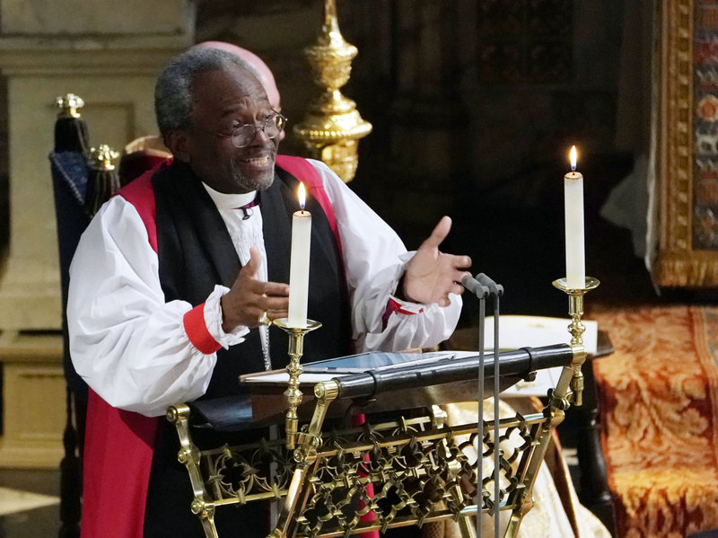
When Love is the Way
The words of Bishop Michael Curry at the wedding of Prince Harry & Meghan Markle
also speak to our hopes
for a better world for our children
and the Way of Jesus Christ as a path to it.
"He didn't die for anything he could get out of it. Jesus did not get an honorary doctorate for dying. He didn't... he wasn't getting anything out of it. He gave up his life, he sacrificed his life, for the good of others, for the good of the other, for the wellbeing of the world... for us.
That's what love is. Love is not selfish and self-centred. Love can be sacrificial, and in so doing, becomes redemptive. And that way of unselfish, sacrificial, redemptive love changes lives, and it can change this world.
If you don't believe me, just stop and imagine. Think and imagine a world where love is the way. Imagine our homes and families where love is the way. Imagine neighbourhoods and communities where love is the way. Imagine governments and nations where love is the way. Imagine business and commerce where this love is the way. Imagine this tired old world where love is the way.
When love is the way - unselfish, sacrificial, redemptive. When love is the way, then no child will go to bed hungry in this world ever again. When love is the way, we will let justice roll down like a mighty stream and righteousness like an ever-flowing brook. When love is the way, poverty will become history. When love is the way, the earth will be a sanctuary. When love is the way, we will lay down our swords and shields, down by the riverside, to study war no more. When love is the way, there's plenty good room - plenty good room - for all of God's children.
Because when love is the way, we actually treat each other, well... like we are actually family. When love is the way, we know that God is the source of us all, and we are brothers and sisters, children of God.
My brothers and sisters, that's a new heaven, a new earth, a new world, a new human family.

Slide 7
Application for the
Baptism of a Child
Preferred Date of Baptism
Full Name of the person to be baptized
Date of Birth & Age
Father’s Full Name
Occupation
Mother’s Full Name
Occupation
Address Telephone & Email

Slide 8
Has the father been Baptized?
Has the mother been Baptized?
Godparents (full names) 1. Have they been baptized/christened? 2. Have they been baptized/christened? 3. Have they been baptized/christened? 4. Have they been baptized/christened?
Signed 1. 2. Data Protection: We would like to be able to contact you about what is going on at St. Mary’s, such as special services or family events. If you do not want your name, and address to be used in this way will you please mark a cross in this box.

